Slide 1
Network Device Access Control
Learning Outcomes:
Access Control Lists (ACL)
Terminal Lines and Password Protection
Authentication, Authorization & Accounting (AAA)
Zone Based Firewalls (ZBFW)
Control Plane Policing (CoPP)
Device Hardening

Slide 2
1. Access Control Lists (ACLs)
Access Control lists also known as ACLs or access-lists.
Sequential list of Access Control Entries (ACEs)
ACEs are permit or deny on a predefined conditional matching statements.
ACLs are hierarchically structured ACEs with implicit deny ACE at the end.
ACL Types:
Numbered Standard ACLs : Classify packets based on source only. Numbered 1-99, 1300-1999
Numbered Extended ACLs : Classify packets based on source and destination (IP & port) and other packet headers. Numbered 100-199, 2000-2699
Named ACLs : Numbered ACLs (standard or extended) defined with names for convenience.
Port ACLs (PACLs) : Standard or Extended (numbered or named) MAC ACLs to filter traffic on switchports (layer 2).
VLAN ACLs (VACLs) : Standard or Extended (numbered or named) MAC ACLs to filter traffic on VLANs.

Slide 3
1. Access Control Lists (ACLs)
ACLs use wild card mask to specify a network.
Wild card mask of a network is obtained by subtracting its subnet mask from 255.255.255.255
Example: Network 192.168.1.0 255.255.255.0
Wild card mask = 255.255.255.255 - 255.255.255.0= 0.0.0.255
Thus, ACL network would be 192.168.1.0 0.0.0.255
ACLs are applied to an interface as ingress(in) or egress(out). An interface can have only one in and one out ACL applied.
ACLs can also be used for NAT, SNMP, Class maps, Route maps and other traffic classification.
ACEs can match traffic from and to a single host Example:192.168.1.1 255.255.255.255 (192.168.1.1/32)
access-list 1 permit 192.168.1.1 0.0.0.0
Instead of writing single host as above, host keyword can be used.
access-list 1 permit host 192.168.1.1
ACEs keyword any :
keyword any is equivalent to specifying:
0.0.0.0 255.255.255.255
access-list 1 permit 0.0.0.0 255.255.255.255
Equivalent to:
access-list 1 permit any

Slide 4
1. Access Control Lists (ACLs)
Steps to configure Standard numbered ACLs:
Define ACL
access-list acl-number {deny|permit} source [source-wildcard] [log]
Apply the ACL to interface in interface configuration mode.
ip access-group {acl-number} {in|out}
Example Standard numbered ACL:
R1(config)# access-list 1 deny 172.16.0.0 0.0.255.255
R1(config)# access-list 1 deny host 192.168.1.1
R1(config)# access-list 1 permit any
R1(config)# interface GigabitEthernet0/1
R1(config-if)# ip access-group 1 in
Steps to configure Extended numbered ACLs:
Define the ACL
access-list acl-number {deny|permit} protocol source source-wildcard destination destination-wildcard [protocol-options] [log | log-input]
[protocol-options] vary depending on protocol, can be lt,gt,eq or SYN, ACK.
log-input to log input interface, source MAC or virtual circuit in log output.
Apply the ACL to interface in interface configuration mode
ip access-group {acl-number} {in|out}
Example Numbered Extended ACL:
R1(config)# access-list 100 deny tcp any any eq 23
R1(config)# access-list 100 deny icmp any any
R1(config)# access-list 100 deny ip host 10.1.2.2 host 10.1.2.1
R1(config)# access-list 100 permit ip any any
R1(config)# interface Gi0/1
R1(config-if)# ip access-group 100 in
Notes:
{ } : Mandatory options , [ ] : Optional options

Slide 5
1. Access Control Lists (ACLs)
Steps to configure named ACL:
Define ACL, goes to ACL configuration mode
ip access-list {standard|extended} {acl-number | acl-name}
Configure the specific ACE in ACL configuration mode.
[sequence] {permit | deny} source source-wildcard
Apply the ACL to interface in interface configuration mode.
ip access-group {acl-number | acl-name} {in|out}
Example named standard ACL:
R1(config)# ip access-list standard STANDARD_ACL
R1(config-std-nacl)# deny 172.16.0.0 0.0.255.255
R1(config-std-nacl)# deny host 192.168.1.1
R1(config-ext-nacl)# permit any
R1(config-ext-nacl)# exit
R1(config)# interface GigabitEthernet0/1
R1(config-if)# ip access-group STANDARD_ACL in
Example named extended ACL:
R1(config)# ip access-list extended EXTENDED_ACL
R1(config-std-nacl)# deny tcp any any eq 23
R1(config-std-nacl)# deny icmp any any
R1(config-std-nacl)# deny ip host 192.168.1.1 any
R1(config-ext-nacl)# permit ip any any
R1(config-ext-nacl)# exit
R1(config)# interface Gi0/1
R1(config-if)# ip access-group EXTENDED_ACL in
Notes:
{ } : Mandatory options , [ ] : Optional options

Slide 6
1. Access Control Lists (ACLs)
Port ACLs (PACLs) : ACLs applied on switchport is called PACL.
ACLs can be any of standard, extended, named or MAC ACLs.
Below are some restrictions of PACLs:
PACLs only support filtering incoming traffic on an interface (no outbound filtering support)
PACLs cannot filter Layer 2 control packets, such as CDP, VTP, DTP, PAgP, UDLD, and STP.
PACLs are supported only in hardware
PACLs do not support ACLs to filter IPv6, ARP, or Multiprotocol Label Switching (MPLS) traffic.
Example:
ip access-list extended PACL-PCA-ISOLATE
permit ip host 192.168.10.10 host 192.168.10.1
deny ip host 192.168.10.10 192.168.10.0 0.0.0.255
permit ip any any
Notes:
{ } : Mandatory options , [ ] : Optional options

Slide 7
1. Access Control Lists (ACLs)
VLAN ACLs (VACLs) : ACLs applied on entire VLAN is called VACL.
VACLs apply to all switchports belonging to the VLAN
VACLs are applied using access-maps and vlan filter.
They apply to traffic bridged inside the VLAN or routed into or out of the VLAN.
Below steps are used to create and apply VACLs:
Define a VLAN access map by using the command vlan access-map name sequence. A VLAN access map consists of one or more VLAN access map sequences where each VLAN access map sequence is composed of one match and one action statement.
Configure the match statement by using the command match{ ip address { acl-number | acl-name } | mac address acl-name }. The match statement supports standard, extended, or named IPv4 ACLs as well as named MAC address ACLs as the matching criteria.
Configure the action statement by using the command action forward|drop [log]. The action statement specifies the action to be taken when a match occurs, which could be to forward or to drop traffic. Only dropped traffic can be logged using the log keyword.
Apply the VACL by using the command vlan filter vlan-access-map-name vlan-list vlan. Vlan-list vlan can be a single VLAN, a range of VLANs (such as 5–30), or a comma-separated list of multiple VLANs (such as 1,2–4,6).
Example VACL:
SW1(config)# ip access-list extended BLOCK-TELNET
SW1(config-ext-nacl)# permit tcp any any eq 23
SW1(config)# vlan access-map TELNET-FILTER 10
SW1(config-access-map)# match ip address BLOCK-TELNET
SW1(config-access-map)# action drop
SW1(config-access-map)# vlan access-map TELNET-FILTER 20
SW1(config-access-map)# action forward
SW1(config)# vlan filter TELNET-FILTER vlan-list 10,20
Notes:
{ } : Mandatory options , [ ] : Optional options

Slide 8
1. Access Control Lists (ACLs)
Inter-operation of PACL, VACL and RACL:
Bridged traffic processing order (within the same VLAN):
Inbound PACL on the switchport (for example, VLAN 10)
Inbound VACL on the VLAN (for example, VLAN 10)
Outbound VACL on the VLAN (for example, VLAN 10)
Routed traffic processing order (across VLANs):
Inbound PACL on the switchport (for example, VLAN 10)
Inbound VACL on the VLAN (for example, VLAN 10)
Inbound ACL on the SVI (for example, SVI 10)
Outbound ACL on the SVI (for example, SVI 30)
Outbound VACL on the VLAN (for example, VLAN 30)
Notes:
{ } : Mandatory options , [ ] : Optional options

Slide 9
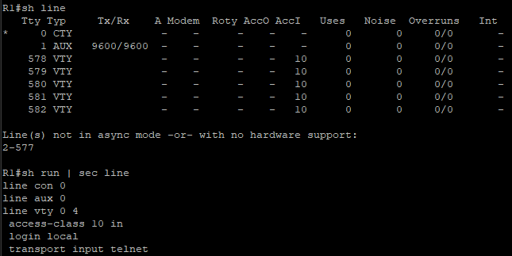
2. Terminal Lines and Password Protection
IOS device CLI access types:
Console port (cty) line : Appears in IOS configurations as line con 0. Used to access the device locally through console terminal.
Auxiliary port (Aux) line: Appears in IOS configurations as line aux 0. Used to access device remotely through a modem.
Virtual Terminal (vty) lines : Appears in IOS configurations as line vty 0 4.They are used to remotely access device through Telnet or SSH.
Below picture shows line types on IOS.
Ways to password protect lines:
Password configured directly on the line. (Not Recommended)
Example: Provide password while accessing console
line console 0
login
password c1sc0
Username based authentication (Recommended as fallback)
Configure username and password in global config mode first.
Example: username User password c1sc0
line console 0
login local
Using AAA Server (Recommended)
Notes:
{ } : Mandatory options , [ ] : Optional options

Slide 10
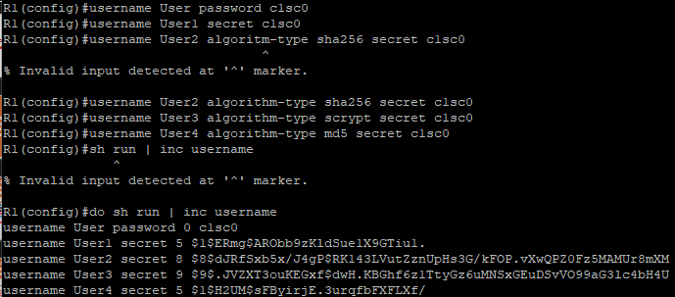
2. Terminal Lines and Password Protection
Password Types:
Types | Encryption | Command | Recommended ?
Type 0 | Clear text | enable password | No
Type 5 | MD5 Hashing | enable secret, See below option 2 & 3 | Yes. Over Type 0 and Type 7
Type 7 | Cisco Vigenere cypher | Service password encryption | Over Type 0
Type 8 | PBKDF2 with SHA256 | See below third option | Yes, Always
Type 9 | SCRYPT Hashing | See below third option | Yes, Over 0,5 & 7
Three different ways of configuring username and password for username based authentication:
Using the command username {username} password {password} configures a plain text password (type 0).
Using the command username {username} secret {password} provides type 5 encryption.
Using the command username {username} algorithm-type {md5 | sha256 | scrypt}secret {password} provides type 5, type 8, or type 9 encryption, respectively.
NOTE: Username-based authentication for the aux and cty lines is only supported in combination with AAA for some IOS releases. Type 8 and 9 enable secret only work on software release after 17.x.x
Notes:
{ } : Mandatory options , [ ] : Optional options

Slide 11
2. Terminal Lines and Password Protection
Privilege levels and Role Based Access Control (RBAC): Privilege levels define which commands are available to a user.
Cisco IOS CLI by default has 3 privilege levels:
Privilege level 0 : Includes disable, enable, exit, help, and logout commands.
Privilege level 1 : Known as User EXEC mode. Available with (Router>) sign and not possible to make configuration changes.
Privilege level 15 : Known as Privileged EXEC mode. Available with (Router#) sign and is highest privilege level. Configure terminal available from this level.
Command privilege {mode} level {level} {command string} can be used to set additional privilege levels from 2 to 14.
Use case: Allow only group of users to access certain interface configuration commands only but not other commands can be set.
Verify current privilege level with:
Show privilege
Set user noc to only configure interfaces:
R1(config)# username noc privilege 5 algorithm-type sha256 secret c1sc0
R1(config)# privilege exec level 5 configure terminal
R1(config)# privilege configure level 5 interface
R1(config)# privilege interface level 5 shutdown
R1(config)# privilege interface level 5 no shutdown
R1(config)# privilege interface level 5 ip address
Notes:
{ } : Mandatory options , [ ] : Optional options

Slide 12
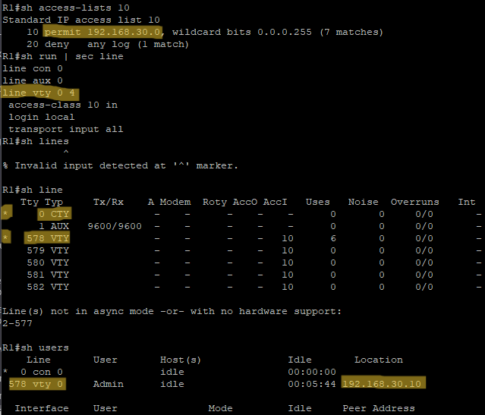
2. Terminal Lines and Password Protection
Access to vty lines can further be controlled with applying ACLs.
Applying standard or extended ACLs on device lines is recommended as it is close to destination.
Command to apply ACLs use access-class instead of access group.
access-class {access-list-number|access-list-name} {in|out}
Similarly, Access to vty lines can further be controlled with command transport input {none|all|telnet|ssh}
Show lines shows which vty ports are being used.
Line console should be configured with transport input none to prevent reverse telnet.
Notes:
{ } : Mandatory options , [ ] : Optional options

Slide 13
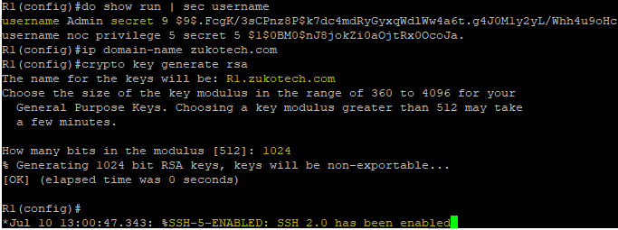
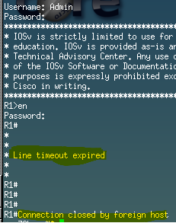
2. Terminal Lines and Password Protection
Enabling SSH vty Access: Secure Shell (SSH) provides strong encryption and authentication.
Steps to configure SSH on IOS devices are as follows:
Configure a hostname other than Router by using the command hostname {name}.
Configure a domain name by using the command ip domain-name {domain-name}
Generate crypto keys by using the command crypto key generate rsa.
Additionally, username and password authentication should be enabled on the device.
By default SSHv1 is enabled, to disable SSHv1 and only connect using SSHv2 use ip ssh version 2 in global configuration mode
Idle user EXEC sessions can be timed out with command exec-timeout {minutes seconds} under line configuration mode.
An absolute time out can be configured with line configuration command absolute-timeout {minutes} that logs out automatically after set timeout even in active connection.
Command logout-warning {seconds} can be used in combination of absolute timeout to give “line termination” warning.
R1#sh run | sec line
line con 0
line aux 0
no exec
line vty 0 4
access-class 10 in
exec-timeout 5 0
logout-warning 15
absolute-timeout 30
login local
transport input all
Notes:
{ } : Mandatory options , [ ] : Optional options

Slide 14
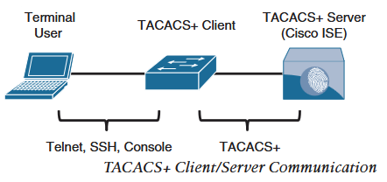
3. AAA
Authentication: Identify and verify users to provide access to network devices and/or services.
Authorization: Defines access privileges and restrictions for authorized users.
Accounting: Maintains security logs of events that includes user access logs, services start and stop times, executed CLI commands and so on.
To carry these packets for services AAA, there are two most popular protocols.
Remote Authentication Dial-in Service (RADIUS)
Terminal Access Controller Access-Control System Plus (TACACS+):
AAA use cases:
Network Device Access Control: Similar to local username and password based authentication, for granularity and scalability, AAA is used to provide access to the network device.TACACS+ is preferred protocol for this use case.
Secure Network Access Control (Services): Obtain identity of device or user before they are allowed to access network. RADIUS is preferred protocol for this use case.
TACACS+
Developed by Cisco and released as Open source.
Mainly used for Network Device access control.
Possible to use for network access control.
Uses TCP port 49 for TACACS+ client server communication.
Notes:
{ } : Mandatory options , [ ] : Optional options

Slide 15
3. AAA
RADIUS and TACACS+ Comparison:
Components | RADIUS | TACACS+
Protocol and Ports | Cisco’s implementation: UDP: port 1645 (auth & author) UDP: port 1646 (acc) Industry standard: UDP: port 1812 (auth & author) UDP: port 1813 (acc) | TCP port 49
Encryption | Encrypts only password field Supports EAP for 802.1x | Encrypts entire payload Does not support 802.1x
Authentication & Authorisation | Combines Auth & Authorisation Cannot be used to authorise individual CLI commands | Separate Auth & Author Can be used to authorise individual CLI commands
Accounting | Does not support network device CLI command accounting | Supports network device CLI command accounting
Primary Use | Secure network access | Network device access control
Steps to configure Cisco IOS network devices as TACACS+ AAA client:
Create local user with full privilege as a fallback to prevent being locked out after configuring TACACS+ using command
username {username} privilege 15 algorithm-type {md5 | sha256 | scrypt} secret {password}
Enable AAA functions by using the command aaa new-model
Based on IOS versions, add TACACS+ AAA server:
Prior to IOS 15.x: tacacs-server host { hostname | host-ip-address } key key-string
IOS 15.x and later:
tacacs server name
address ipv4 { hostname | host-ip-address }
key key-string
Cisco Secure Access Control Server(ACS) was the AAA server for network device access control using TACACS+ and secure network access using RADIUS, which is now updated to Cisco Identity Services Engine (ISE).
Steps to configure TACACS+ for network device access:
Configure network device as TACACS+ AAA client.
Configure TACACS+ AAA server such as ISE.
Notes:
{ } : Mandatory options , [ ] : Optional options

Slide 16
3. AAA
Steps to configure Cisco IOS network devices as TACACS+ AAA client:
Create AAA server group for failover, priority top to bottom in order of addition
aaa group server tacacs+ group-name
server name server-name
Enable AAA login Authentication with command
aaa authentication login { default | custom-list-name } method1 [method2 . . .]
Example: aaa authentication login default group ISE-TACACS+ local enable
keyword default applies method lists to all lines in default order, ISE-TACACS+ servers used first then local username and password authentication and then enable password. If none configured, user is locked out.
creating custom-list-name allows to apply methods defined in method list to be applied to lines separately.
To apply custom method list to lines use login authentication custom-list-name under line configuration.
Enable AAA authorization for EXEC by using the command:
aaa authorization exec { default | custom-list-name } method1 [ method2 . . . ]
Enable AAA authorization for the console by using the command:
aaa authorization console
Authorization for the console is disabled by default to prevent inexperienced users from locking themselves out.
Enable AAA authorization for commands by using the command:
aaa authorization commands {privilege level} { default | custom-list-name } method1 [ method2 . . . ]
This authorises all commands with AAA server before executing them. AAA authorisation for privilege levels 0,1 and 15 is commonly used.
Enable command authorization in global configuration mode (and all global configuration submodes):
aaa authorization config-commands
Enable login accounting by using the command:
aaa accounting exec { default | custom-list-name } method1 [ method2 . . . ]
It is common to use the keyword start-stop for AAA accounting. It causes accounting to start as soon as a session starts and stop as soon as the session ends.
Enable command accounting by using the command:
aaa accounting commands {privilege level} { default | custom-list-name } method1 [ method2 . . . ]
Just as with authorization, command accounting is applied per privilege level, so it is necessary to configure a command accounting method list for every privilege level that requires command accounting.
Notes:
{ } : Mandatory options , [ ] : Optional options

Slide 17
3. AAA
Example Configuration:
aaa new-model
tacacs server ISE-PRIMARY
address 10.10.10.1
key my.S3cR3t.k3y
tacacs server ISE-SECONDARY
address 20.20.20.1
key my.S3cR3t.k3y
aaa group server tacacs+ ISE-TACACS+
server name ise-primary
server name ise-secondary
aaa authentication login default group ISE-TACACS+ local
aaa authentication login CONSOLE-CUSTOM-AUTHENTICATION-LIST local line enable
aaa authentication enable default group ISE-TACACS+ enable
aaa authorization exec default group ISE-TACACS+ if-authenticated
aaa authorization exec CONSOLE-CUSTOM-EXEC-AUTHORIZATION-LIST none
aaa authorization commands 0 CONSOLE-CUSTOM-COMMAND-AUTHORIZATION-LIST none
aaa authorization commands 1 CONSOLE-CUSTOM-COMMAND-AUTHORIZATION-LIST none
aaa authorization commands 15 CONSOLE-CUSTOM-COMMAND-AUTHORIZATION-LIST none
aaa authorization commands 0 default group ISE-TACACS+ if-authenticated
aaa authorization commands 1 default group ISE-TACACS+ if-authenticated
aaa authorization commands 15 default group ISE-TACACS+ if-authenticated
aaa authorization console
aaa authorization config-commands
aaa accounting exec default start-stop group ISE-TACACS+
aaa accounting commands 0 default start-stop group ISE-TACACS+
aaa accounting commands 1 default start-stop group ISE-TACACS+
aaa accounting commands 15 default start-stop group ISE-TACACS+
line con 0
authorization commands 0 CONSOLE-CUSTOM-COMMAND-AUTHORIZATION-LIST
authorization commands 1 CONSOLE-CUSTOM-COMMAND-AUTHORIZATION-LIST
authorization commands 15 CONSOLE-CUSTOM-COMMAND-AUTHORIZATION-LIST
authorization exec CONSOLE-CUSTOM-EXEC-AUTHORIZATION-LIST
privilege level 15
login authentication CONSOLE-CUSTOM-AUTHENTICATION-LIST
line vty 0 4
<uses default method-lists for AAA>
if-authenticated keyword can be viewed as the fallback method list which if that method list is hit due to other previous method list unreachability (failure), It authorizes the user if authenticated using any of the authentication methods listed in aaa authentication section.
none disables authorization, here once authenticated for console, no authorization is being checked for privilege levels 0,1 and 15
Notes:
{ } : Mandatory options , [ ] : Optional options

Slide 18
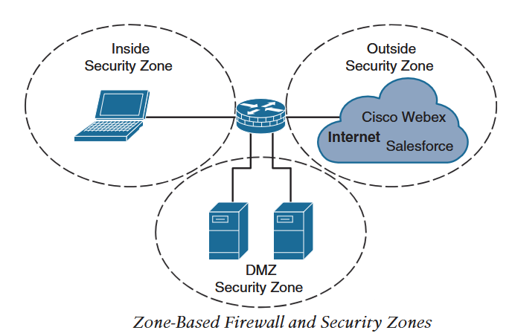
3. ZBFW
Cisco IOS and IOS XE devices include statefull layer 4 firewall function known as Zone Based Firewall (ZBFW).
statefull Layer 4 firewall allow/deny traffic based on connection states rather than only based on source and destination.
Thus, they do not require reverse rule for a connection to work.
Firewall that allows/denies traffic based on security zones are ZBFW.
Security Zones are trust boundaries, where interfaces on one security zone cannot communicate with interfaces on another security zone by default.
Zones in Cisco IOS ZBFW:
Self Zone: System level zone that includes all router’s ip addresses. By default all communication to and from this zone are allowed as it contains management (SNMP,SSH) and control plane (OSPF, BGP) traffic.
Default Zone: System level zone that includes all router interfaces by default if not associated with any other security zones.
Notes:
{ } : Mandatory options , [ ] : Optional options

Slide 19
3. ZBFW
Steps to configuring Outside zone on internet facing interface:
Define zone with command zone security zone-name
zone security OUTSIDE
description OUTSIDE zone for internet interface
Define inspection class map. A class map for inspection defines a method for classifying traffic for inspection.
class-map type inspect [match-all | match-any] class-name
Match all matches all conditions (boolean AND) match-any matches any one of the conditions (boolean OR). Default is match-all
class-map type inspect match-any OUTSIDE-TO-SELF-INSPECT
match access-group name IPSEC-ACL
match access-group name PING-AND-TRACEROUTE
class-map type inspect match-any OUTSIDE-TO-SELF-PASS
match access-group name DHCP-IN
match access-group name ESP-ACL
match access-group name GRE-ACL
Verify with show class-map type inspect
Ip access-list extended IPSEC-ACL
permit udp any any eq non500-isakmp
permit udp any any eq isakmp
Ip access-list extended PING-AND-TRACEROUTE
permit icmp any any echo
permit icmp any any echo-reply
permit icmp any any ttl-exceeded
permit icmp any any port-unreachable
permit udp any any range 33434 33463 ttl eq 1
Ip access-list DHCP-IN
permit udp any eq bootps any eq bootpc
Ip access-list extended ESP-ACL
permit esp any any
Ip access-list extended GRE-ACL
permit gre any any
Notes:
{ } : Mandatory options , [ ] : Optional options

Slide 20
3. ZBFW
Steps to configuring Outside zone on internet facing interface:
Define the inspection policy map. Which applies firewall policy actions to the class maps. The policy maps are then applied to security zone pair.
The policy map is defined with command: policy-map type
inspect policy-name
Firewall policy actions can be:
Drop[log]: Silently drops the packets that match the class map. Optional log keyword logs the drop matches.
Pass[log]: Unidirectional passing of the packets from source to destination zone that matches the class map. Reverse policy is required for bidirectional passing of the packets.
Inspect: State-based traffic control. Keeps information about the connection/session thus allowing traffic in reverse direction automatically.
Policy-map type inspect POLICY-OUTSIDE-TO-SELF
class type inspect OUTSIDE-TO-SELF-INSPECT
inspect
class type inspect OUTSIDE-TO-SELF-PASS
pass
class class-default
drop
Although a default drop is implied, specifying makes it easier to troubleshoot.
Verify using show policy-map type inspect
Create security zone pair and apply the policy map to security zone pair with command:
zone-pair security zone-pair-name source source-zone-name destination destination-zone-name
service-policy type inspect policy-name
zone-pair security OUTSIDE-TO-SELF source OUTSIDE destination self
service-policy type inspect POLICY-OUTSIDE-TO-SELF
Apply security zones to appropriate interfaces by entering interface configuration command and using:
interface interface-id
zone-member security zone-name
zone-member security OUTSIDE
Notes:
{ } : Mandatory options , [ ] : Optional options

Slide 21
3. ZBFW
Verify Security zones
Router#sh policy-map type inspect zone-pair OUTSIDE-TO-SELF
Zone-pair: OUTSIDE-TO-SELF
Service-policy inspect : OUTSIDE-TO-SELF
Class-map: OUTSIDE-TO-SELF-INSPECT (match-any)
Match: access-group name IPSEC-ACL
Match: access-group name PING-AND-TRACEROUTE
Inspect
Session creations since subsystem startup or last reset 0
Current session counts (estab/half-open/terminating) [0:0:0]
Maxever session counts (estab/half-open/terminating) [0:0:0]
Last session created never
Last statistic reset never
Last session creation rate 0
Last half-open session total 0
Class-map: OUTSIDE-TO-SELF-PASS (match-any)
Match: access-group name ACL-DHCP-IN
Match: access-group name ACL-GRE
Match: access-group name ACL-ESP
Pass
0 packets, 0 bytes
Class-map: class-default (match-any)
Match: any
Drop
61 packets, 8714 bytes
Router#ping 8.8.8.8
Type escape sequence to abort.
Sending 5, 100-byte ICMP Echos to 8.8.8.8, timeout is 2 seconds:
.....
Success rate is 0 percent (0/5)
Ping is not successful as the policy is applied to zone-pair outside to self.
To fix ping, a policy is required for self-zone to outside-zone zone-pair:
We will use same PING-AND-TRACEROUTE access list.
class-map type inspect match-any SELF-OUTSIDE-INSPECT
match access-group name PING-AND-TRACEROUTE
policy-map type inspect POLICY-SELF-TO-OUTSIDE
class type inspect SELF-OUTSIDE-INSPECT
inspect
class class-default
drop
Zone-pair security SELF-TO-OUTSIDE source self destination OUTSIDE
service-policy type inspect POLICY-SELF-TO-OUTSIDE
Router#sh policy-map type inspect zone-pair SELF-TO-OUTSIDE
Zone-pair: SELF-TO-OUTSIDE
Service-policy inspect : POLICY-SELF-TO-OUTSIDE
Class-map: SELF-OUTSIDE-INSPECT (match-any)
Match: access-group name PING-AND-TRACEROUTE
Inspect
Packet inspection statistics [process switch:fast switch]
icmp packets: [0:20]
Session creations since subsystem startup or last reset 2
Current session counts (estab/half-open/terminating) [0:0:0]
Maxever session counts (estab/half-open/terminating) [2:0:0]
Last session created 00:05:03
Last statistic reset never
Last session creation rate 0
Last half-open session total 0
Class-map: class-default (match-any)
Match: any
Drop
4 packets, 176 bytes
Router#ping 8.8.8.8
Type escape sequence to abort.
Sending 5, 100-byte ICMP Echos to 8.8.8.8, timeout is 2 seconds:
!!!!!
Success rate is 100 percent (5/5), round-trip min/avg/max = 12/13/15 ms
Notes:
{ } : Mandatory options , [ ] : Optional options

Slide 22
3. CoPP
Control Plane Policing (CoPP) : QoS policy to police the traffic to or from router’s control plane.
Generally this is done to rate limit the control plane traffic towards router CPU to control CPU load.
Traffic (management, routing protocols and other known ip addresses) is classified using traffic classes and a QoS policy to rate limit those classes is applied.
Information required to classify the traffic can be obtained from protocol documentation or protocol packet captures.
A QoS policy can police traffic as per keywords confirm, exceed or violate.
The rate for policing a traffic class needs to be pre-determined and can be changed as per the requirements.
Steps to configure CoPP:
Define ACL to capture particular traffic using: ip access -list extended ACL-Name
ip access-list extended ACL-CoPP-ICMP
permit icmp any any echo !(ping request)
permit icmp any any echo-reply !(ping reply)
permit icmp any any time-exceeded !(tr-receive)
permit icmp any any port-unreachable !(tr-receive)
permit udp any any range 33434 33463 ttl eq 1 !(tr-send)
ip access-list extended ACL-CoPP-IPSec
permit udp any any eq non500-isakmp
permit udp any eq non500-isakmp any
permit udp any eq isakmp any eq isakmp
permit esp any any
permit gre any any
ip access-list extended ACL-CoPP-Management
permit udp any eq ntp any
permit udp any any eq snmp
permit tcp any any eq 22
permit tcp any eq 22 any established
Ip access-list extended ACL-CoPP-Initialize
permit udp any eq bootps any eq bootpc
Ip access-list extended ACL-CoPP-Routing
permit tcp any eq bgp any established
permit eigrp any host 224.0.0.10
permit ospf any host 224.0.0.5
Permit ospf any host 224.0.0.6
permit pim any host 224.0.0.13
permit igmp any any
Notes:
{ } : Mandatory options , [ ] : Optional options

Slide 23
3. CoPP
Steps to configure CoPP
Classify captured traffic using class maps using: class map [match-all|match-any] class-map-name
class-map match-all CLASS-CoPP-IPsec
match access-group name ACL-CoPP-IPsec
class-map match-all CLASS-CoPP-Routing
match access-group name ACL-CoPP-Routing
class-map match-all CLASS-CoPP-Initialize
match access-group name ACL-CoPP-Initialize
class-map match-all CLASS-CoPP-Management
match access-group name ACL-CoPP-Management
class-map match-all CLASS-CoPP-ICMP
match access-group name ACL-CoPP-ICMP
Apply policy to traffic classes using policy maps: policy-map policy-map-name
Policing rate (CIR/PIR in bits per second) can be adjusted overtime.
Policing action confirm: transmit, exceed: transmit and violate: drop is applied to traffic classes. For critical protocols, violate: confirm is applied.
policy-map POLICY-CoPP
class CLASS-CoPP-IPSec
police 64000 confirm-action transmit exceed-action transmit
violate-action transmit
class CLASS-CoPP-ICMP
police 8000 confirm-action transmit exceed-action transmit
violate-action drop
class CLASS-CoPP-Initialize
police 8000 confirm-action transmit exceed-action transmit
violate-action drop
class CLASS-CoPP-Management
police 32000 confirm-action transmit exceed-action transmit
violate-action drop
class CLASS-CoPP-Routing
police 64000 confirm-action transmit exceed-action transmit
violate-action transmit
class class-default
police 8000 conform-action transmit exceed-action transmit
violate-action drop
Apply policing to control plane by using:service policy input policy-map-name
control plane
service-policy input POLICY-CoPP
Notes:
{ } : Mandatory options , [ ] : Optional options

Slide 24
3.Device Hardening
Verify CoPP using show policy-map control-plane input
Device Hardening: Disabling unnecessary services improves overall security posture of the device and reduces CPU and memory load.
Below services can be disabled:
Topology discovery tools: CDP and LLDP can provide unnecessary information to routers outside your control. Disable with no cdp enable, no lldp transmit and no lldp receive in interface configuration mode.
TCP and UDP small services: service tcp-keepalive-in and service tcp-keepalive-out ensure that devices send TCP keepalives for inbound/outbound TCP sessions. This cleans up orphaned and half open TCP connections by making sure remote TCP endpoint sends keepalives.
IP redirect services: no ip redirects command under interface configuration stops ICMP redirect which is used to inform existence of better path to traffic that is hairpining on a router. Traffic hairpining is forcing packets to take path via the router regardless of other best paths. It is done if traffic needs to be inspected for security reason or NAT translation is needed to reach the destination.
Proxy ARP: no ip proxy-arp disables proxy arp. Router with proxy arp replies to arp requests on behalf of other devices.
Service configuration: Cisco devices support automatic configuration from remote TFTP. This should be disabled with no service config
Maintenance Operation Protocol (MOP) service: MOP should be disabled using command no mop enabled in global and interface configuration mode.
Packet Assembler/Disassembler (PAD) Service: This service is needed for x.25 protocol. This can be disabled with no service pad command.
Notes:
{ } : Mandatory options , [ ] : Optional options

